Slide 1
Building and Leading
High-Performing Teams
Lectures Based on
Leadership Communication
By Deborah J. Barrett, Ph.D.

Slide 2
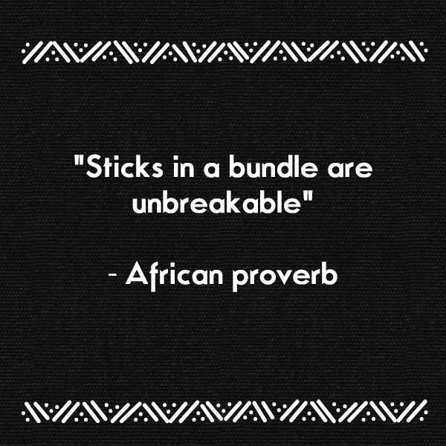
Chapter 8 - <number>

Slide 3
Chapter 8 - <number>
https://www.youtube.com/watch?v=hHIikHJV9fI

Slide 4
Discussion Topics
Chapter 8 - <number>
Building an effective team
Establishing team work processes
Managing the people side of teams
Handling team issues and conflict
Helping virtual teams succeed

Slide 5
Katzenbach and Smith “real” team:
Chapter 8 - <number>
Complementary skills (problem solving, technical/functional, interpersonal).
Accountability (mutual, individual, and small number of people).
Commitment (specific goals, common approach, meaningful purpose).

Slide 6
Real Team
Chapter 8 - <number>
Complement
Recognize and accept
Accountability
Bringing together the right people
Deciding how to work with the members to achieve high performance

Slide 7
Real Team
Chapter 8 - <number>
6. Communicate
-team purpose
-objectives
-expectations
-roles and responsibilities
-ground rules
-communication protocol

Slide 8
Katzenbach and Smith’s Team Basics
Chapter 8 - <number>
Performance Results
Skills
Problem solving
Accountability
Mutual
Technical function
Individual
Small number of people
Interpersonal
Specific goals
Common approach
Meaningful purpose
Collective Work Products
Commitment
Personal Growth
Source: Katzenbach, J. R. and Smith, D. K., (1993). The Wisdom of Teams, Boston: Harvard Business School Press.

Slide 9
Establishing Team Work Processes
Chapter 8 - <number>
Create a team charter
Establish a team communication protocol
Create action and work plans
Conduct effective meetings
Use common team problem-solving methods

Slide 10
Creating a Team Charter
Chapter 8 - <number>
A charter should include the following:
  Project purpose/objectives
  Guiding principles (ground rules)
  Major tasks or action items
  Team members with role definitions
  Communication protocol

Slide 11
Team Charter
Chapter 8 - <number>
Team Values
Communication guidelines
Decision-making criteria and processes
Conflict resolution process
Meeting guidelines
Team agreements

Slide 12
Who Creates a Team Charter
Chapter 8 - <number>
Does the team leader create the team charter and have the team follow it.
The team charter works best when the team develops it or at least has a n opportunity to contribute to it. By distributing the responsibility of creating the document, you also distribute the responsibility of ensuring that it is followed.
The team charter is also used to orient and integrate new team members.

Slide 13
Creating a Team Charter
Chapter 8 - <number>
A document that establishes expectations regarding acceptable behavior by project team members.
It also establishes team values, agreements and operating guidelines for the team.
Having the project team members commit to clear guidelines decreases misunderstanding and increases productivity.

Slide 14
Chapter 8 - <number>
Developing a Team
Communication Protocol
What events or situations will trigger communication with each other?
2. When will we contact a member of the team versus the entire team?
3. Who will be the spokesperson for most team internal communication? For external communication (that is, with other groups within the company or even outside the company)?

Slide 15
Chapter 8 - <number>
4. What information needs to be communicated to the team?
5. How should we communicate everyday messages, work plan items, end products, questions, emergencies, and the like?
6. To whom do we communicate problems, questions, concerns, and so on?
7. Is there a shared workspace where communication with the team can be centralized? If so, what should be placed in this workspace, when, and by whom?

Slide 16
Chapter 8 - <number>
Developing a Team
Communication Protocol
When
Why?
Who?
What?
How?
To whom?

Slide 17
Chapter 8 - <number>
Establishing Team Action Plans
Establish your overall project goal.
Break the project down into phases.
Specify your team action steps for each phase.
Determine timing for each phase.
5. Create work plan actions linked to each phase.
Research
Current
Image
Determine
Value
Proposition
Develop
Marketing
Plan

Slide 18
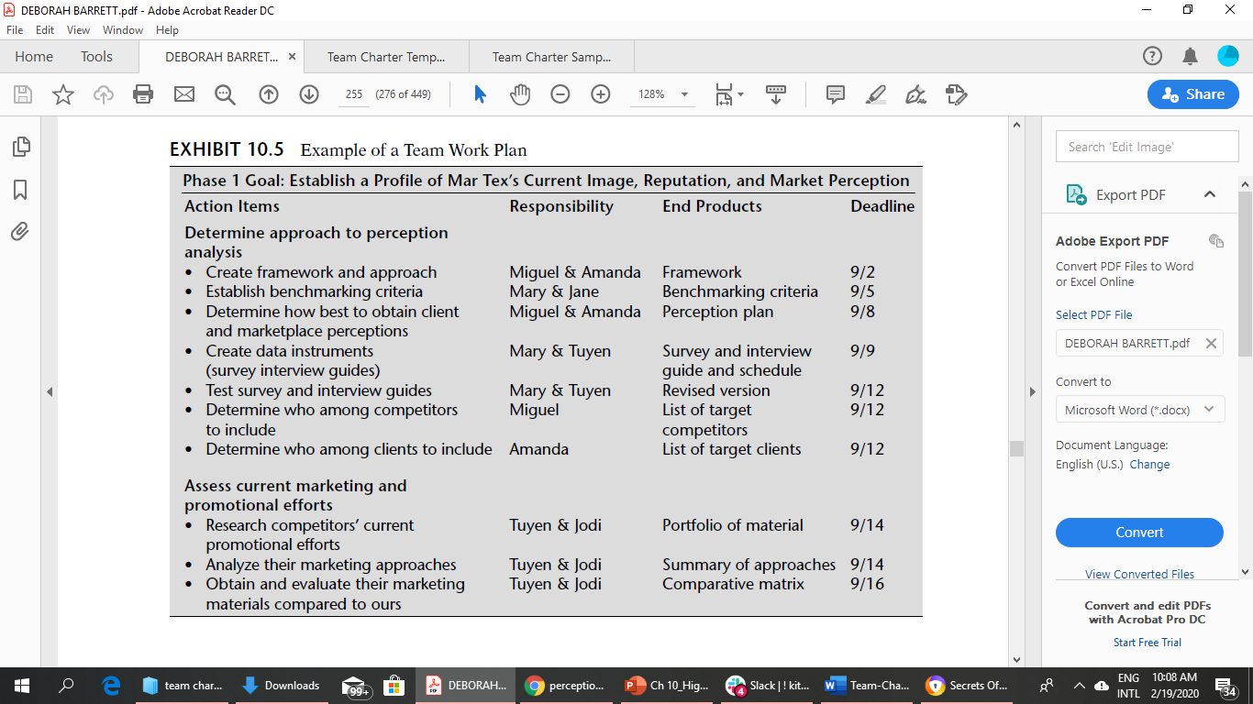
Chapter 8 - <number>

Slide 19
Chapter 8 - <number>
Creating Work Plans
Action item
Responsibility
End product
Due Date
Insert very specific action items, steps to be included in each high-level action plan phase.
Assign to specific person(s), not the entire team.
Describe as a tangible, completed product.
Determine the target date for completion.

Slide 20
Managing the People Side of Teams
Chapter 8 - <number>
Position and responsibilities
Team experiences
Expectations
Personality
Cultural differences

Slide 21
Types of Team Conflict
Chapter 8 - <number>
Analytical – usually constructive disagreement over issue or problem
Task – goal, work process, deliverables
Interpersonal – personality, culture, communication styles
Roles – leadership, responsibilities, power struggles

Slide 22
Approaches to Handling Team Conflict
Chapter 8 - <number>
One-on-one – individuals work it out between themselves
Facilitation – individuals work with a facilitator
Team – Individuals discuss it with the entire team

Slide 23
Keeping Teams out of Trouble
Chapter 8 - <number>
Have an official team launch
Obtain any needed training in team management
Develop and post team ground rules and expectations in team behavior
Educate team members on what to expect in team development
Source: Adapted from Bens, I (1999). “Keeping Your Teams Out of Trouble.” Journal of Quality and Participation, 22 (4): 45- 47.

Slide 24
Keeping Teams out of Trouble (continued)
Chapter 8 - <number>
Anticipate the roadblocks to team performance early and deal with them
Use feedback among team members properly and regularly
Provide feedback to the team leader on what is working and what isn’t
Build in team process checks to monitor the effectiveness of the team
Source: Adapted from Bens, I (1999). “Keeping Your Teams Out of Trouble.” Journal of Quality and Participation, 22 (4): 45- 47.

Slide 25
Discussion Summary
Chapter 8 - <number>
Building and leading a high-performing team requires the following:
  Skills, commitment, and accountability
  Common team work processes
  Understanding of the people side of teams
  Ability to handle team issues and conflict

